Slide 1
VERSION CONTROL SYSTEM
Yuliia Kholina

Slide 2

VCS – WTF?
The management of changes to documents, programs and other information stored as computer files
Every file:
Has a full history of changes
Can be restored to any version

Slide 3

Centralized VCS
Single (centralized) master copy of the code base
Pieces of the code that are being worked on are typically locked (or “checked out”)
Access to the code base and the locking is controlled by the server
When the developer checks their code back in, the lock is released so it’s available for others to check out

Slide 4
Centralized VCS
Everyone knows to a certain degree what everyone else on the project is doing;
Administrators have fine-grained control over who can do what;
Very easy to administrate;
If server goes down everybody drinks coffee studies documentation;
Remote commits are slow;

Slide 5
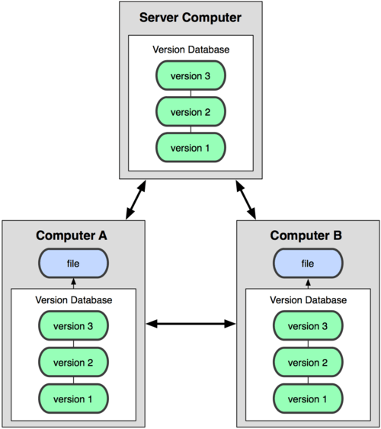
Distributed VCS
The code base is distributed amongst the individual developers’ computers;
There is no locking of parts of the code;
Developers make changes in their local copy and then merge their changes into the master copy;

Slide 6
Distributed VCS
No dependence from server;
Everybody can work offline;
Performing actions other than pushing and pulling changesets is extremely fast because the tool only needs to access the hard drive, not a remote server.
If your project contains many large, binary files that cannot be easily compressed, the space needed to store all versions of these files can accumulate quickly.
If your project has a very long history (50,000 changesets or more), downloading the entire history can take an impractical amount of time and disk space.

Slide 7

Git
GIT-a

Slide 8
Git
Branch
Pull
Push
Commit
Master
Staging
Stash
Preview of your next commit
Repository's "default" branch
Command that creates a snapshot of the staged changes
Command to update the local version of a repository from a remote
Command is used to upload local repository content to a remote repository
A lightweight movable pointer to one of these commits

Slide 9
Git
Branch A lightweight movable pointer to one of these commits
Pull Command to update the local version of a repository from a remote
Push Command is used to upload local repository content to a remote repository
Commit Command that creates a snapshot of the staged changes
Master Repository's "default" branch
Staging Preview of your next commit

Slide 10
Let’s practice
https://githowto.com
https://learngitbranching.js.org/

Slide 11

Conflicts

Slide 12
Git workflow
Master: pull
Commit…Commit…Commit
Create Merge Request
Merge to Master
Create new branch YOUR_FEATURE

